Slide 1
User Interfaces and Integration (WP6)
Yvan Lussaud, OBEO

Slide 2
Software stack
Integration GUI
Semantic annotation
Ontology
GUI
Connector (Text, EMF, Ontology,…)
GUI
Specific Locations (Text, EMF, Ontology,…)
Mapping API
Storage (XMI)

Slide 3
WP6 Integration
Components
Mapping API and implementation (EMF/XMI)
Text and model (EMF and ontology) connectors
Semantic annotation
Continuous integration
Next steps
Travis https://travis-ci.org/ModelWriter/Source
Integrate semantic parsing and consistency checking
Develop synchronization API and GUI
Nightly and release builds
Eclipse update sites for each build

Slide 4
Software stack
Integration GUI
Semantic annotation
Ontology
Mapping GUI
Connectors
(Text, EMF, Ontology,…)
Semantic GUI
Specific Locations
(Text, EMF, Ontology,…)
Mapping API
Storage (XMI)
Semantic parsing
Synchronization
Automated reasoning about locations and links
Consistency checking

Slide 5
WP6 Evaluation
Code
Release 1: 19K line of codes and 13K lines of comment
Release 2: 30K line of codes and 20K lines of comment
Commits
Tests
Release 2: 88 commits
Release 1: 60 commits
Release 2: 688 unit tests + some RCPTT tests
Release 1: 403 unit tests

Slide 6
WP6 Release 2
Eclipse update sites
Two update sites one for EPL features and one for GPL features
Mapping features
Semantic features
Mapping base saved to XMI
Text, EMF Model full support and ontology partial support
Text extraction from .doc and .docx files
Semantic annotation and mapping creation from annotation
EMF/XMI mapping base creation wizard
Main ontology format supported (RDF, OWL, Turtle, …)
Eclipse: Luna, Mars, Neon
http://modelwriter.obeo.fr/download

Slide 7
Deliverables for WP6
Kind | Name | Status
Software | D6.3.1-2 Writer enhancements (release 2) | Done
Software | D6.4.2-2 User Interface for the Writer part (release 2) | Done
Software | D6.4.3-2 IDE-integrated User Interface to handle Sync issues (major release 2) | Done
Document | D6.5.1-2 Acceptance Test Plan (release 2) | Merged
Software | D6.5.2-2 Automated Acceptance Tests (release 2) | Done
Document | D6.6.1-2 Acceptance Test Procedures (release 2) | Merged
Software | D6.7.1-2 ModelWriter major release (release 2) | Done
Software | D6.7.2-2 WP2 Integration in ModelWriter and Documentation (release 2) | Done
Document | D6.8.1-2 Evaluation report (release 2) | Coming soon

Slide 8
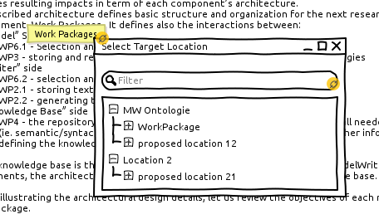
WP6 Ergonomics
Completion/quick outline
+ limit interactions to a minimum
- Need to know what can be targeted (not possible for text)
- Project possible targets out of their editing form

Slide 9
WP6 Ergonomics
Goals
No projection / get elements from the editor
Palette
Possible improvements
Link to elements in the palette
Add element from editors to the palette
Use current selection and an action on element from the palette ?
Quick outline with elements of the palette ?
Works with graphics
Works with text
Eclipse view

